Slide 1
INSTRUCTIONS
Use Font size 22 to 28 and Font Style Times New Roman (body)
Do not change the Template: Heading / Title of the slides
Do not change font style or colours
Do not copy paste paragraphs: use only Bullet Points
Maximum slide Limit is 20 only
As per the number of supervisor allotted adopt slide-2 or slide-3
Please display the required meaningful Content or images or tables
Change the footer accordingly using insert tab then click on header & footer tab and edit it
Save the PPT with Register No, Dept and Review no, example: 23xxxxxxxxx_CSE

Slide 2

Title: Optimized Pharmacy Stock Management System
Student Name: Anikha Padala
Student ID: 2520030613
Cluster:3
Section: 10
Under the Guidance
of
Supervisor Name: Dr. Jayaram Boga
Assistant Professor
Department of CSE

Slide 3
OUTLINE
Abstract
Existing System
Proposed System
System Architecture
Project Modules
Objectives
Co’s Attainments - FWD
Co1
Co2 …….. 5. Co5
Co’s Attainments - DSA
Co1
Co2 …….. 5. Co5
Screen Shots for FWD & DSA
Conclusion
Geo-Tagged Photos

Slide 4
Abstract
Web-based platform to help users recover lost digital accounts.
Users can submit recovery requests with verification details.
Admin reviews and manages requests through a control panel.
Reduces manual effort and organizes recovery processes.
Improves security and transparency in account recovery.
Built using HTML, CSS, JavaScript, and database support.

Slide 5
Existing System
Users must rely on different recovery methods for each platform, which can be confusing and time-consuming.
Many account recovery processes require manual verification, causing delays.
Users often forget recovery emails, phone numbers, or security answers, making recovery difficult.
There is no centralized platform to manage or track digital account recovery requests.
Recovery processes can sometimes be complex and stressful for users who are not technically experienced.
Lack of proper tracking leads to slow response time and poor communication during recovery.

Slide 6
Proposed System
The system provides a centralized platform for submitting digital account recovery requests.
Users can easily submit account details and verification information through an online form.
An admin dashboard allows administrators to review and manage recovery requests efficiently.
The system helps organize and track recovery cases in a structured manner.
It reduces manual workload and simplifies the recovery process for both users and administrators.
The platform improves security, transparency, and response time in handling digital account recovery.

Slide 7
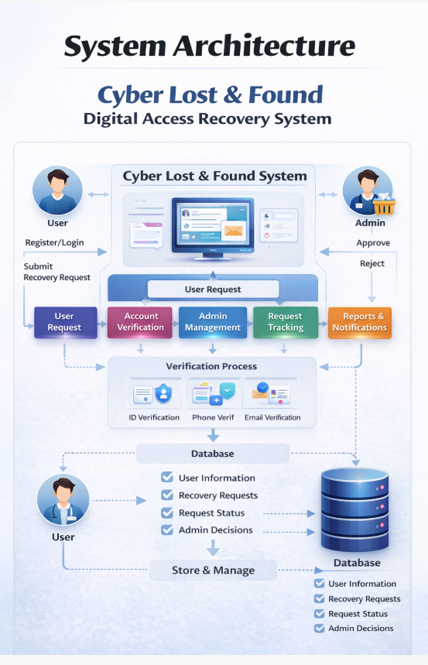
System Architecture

Slide 8
Project Modules
The User Authentication Module allows users to register and log into the system securely.
• The Recovery Request Module enables users to submit requests for recovering lost or inaccessible digital accounts.
• The Account Verification Module verifies user identity using details such as email, phone number, or supporting documents.
• The Admin Management Module allows administrators to review, approve, or reject recovery requests.
• The Request Tracking Module helps users check the status of their recovery requests.
• The Database Module securely stores user details, recovery requests, and verification information.

Slide 9
Objectives
To develop a web-based platform that helps users recover lost or inaccessible digital accounts.
To provide a secure login and registration system for users and administrators.
To allow users to submit digital account recovery requests with necessary verification details.
To enable administrators to review, verify, and manage recovery requests efficiently.
To provide request tracking so users can check the status of their recovery requests.
To ensure secure storage and management of user data through a centralized database.

Slide 10
Co’s Attainments - FWD
1. CO 1-
CO1 Syllabus | CO1 Concepts Included in Project
• Designing structured web pages using HTML elements and forms. • Creating layouts using headings, inputs, buttons, and containers. • Developing user interface components for web applications. | • Developed Login, Registration, Admin Dashboard, and Store pages using HTML. • Used input fields, select dropdowns, buttons, and forms for user interaction. • Organized content using div containers and layout structures.

Slide 11
Co’s Attainments - FWD
2. CO 2-
CO2 Syllabus | CO2 Concepts Included in Project
• Applying CSS for styling and layout design. • Using colors, typography, and visual effects. • Designing responsive and attractive user interfaces. | • Implemented gradient backgrounds and modern UI design. • Used CSS variables, hover effects, shadows, and border radius. • Designed medicine cards, admin dashboard grid, and styled buttons.

Slide 12
Co’s Attainments - FWD
3. CO 3-
CO3 Syllabus | CO3 Concepts Included in Project
Implementing client-side scripting using JavaScript. Writing functions and conditional logic. Handling user inputs and dynamic webpage behavior. | • Implemented features such as login, registration, and medicine inventory management. • Developed cart operations, checkout process, and order history display. • Used functions like login(), register(), addaccount(), recoverpassword.

Slide 13
Co’s Attainments - FWD
4. CO 4-
CO4 Syllabus | CO4 Concepts Included in Project
• DOM manipulation and dynamic content updates. • Event handling in web applications. • Updating web page elements without reloading. | • Used document.getElementById() and innerHTML for DOM updates. • Implemented events such as onclick, onkeyup, and onchange. • Dynamically recover / set password, recovery status, and admin dashboard.

Slide 14
Co’s Attainments - FWD
5. CO 5-
CO5 Syllabus | CO5 Concepts Included in Project
• Managing application data in web applications. • Using client-side storage techniques. • Organizing data using programming structures. | • Stored data using LocalStorage and JSON objects. • Maintained accounts of syudents, checks recover password status. • Used Stack, Queue, and Map data structures for efficient data management.

Slide 15
Co’s Attainments - DSA
1. CO 1-
CO1 Syllabus | CO1 Concepts Included in Project
• Algorithm analysis using Big-O notation and efficiency concepts. • Understanding searching techniques and performance comparison. • Applying problem solving strategies for algorithmic solutions. | Searching techniques are used to find user accounts or recovery requests quickly in the database/system. Algorithm efficiency concepts help in optimizing request processing and data retrieval speed. Sorting can be used to organize recovery requests based on date, priority, or status.

Slide 16
Co’s Attainments - DSA
2. CO 2-
CO2 Syllabus | CO2 Concepts Included in Project
• Design and implementation of Abstract Data Types (ADTs). • Use of arrays and linked structures for storing and managing data. • Performing operations like insert, delete, search, and traversal. | Arrays and Linked List concepts help in managing lists such as user requests, recovered accounts, and reported issues. Operations like insert, delete, search, and traverse are used to manage recovery request records. Data structure design helps in efficient storage and retrieval of user information.

Slide 17
Co’s Attainments - DSA
3. CO 3-
CO3 Syllabus | CO3 Concepts Included in Project
• Application of stack and queue data structures in real-world scenarios. • Understanding workflows using linear data structures. • Efficient processing of sequential operations. | Queue data structure can be used to manage recovery requests in the order they are received (first come, first served). Priority queues help admins handle urgent recovery requests first. Stack concepts can be applied for session handling or undo operations in system workflows.

Slide 18
Co’s Attainments - DSA
4. CO 4-
CO4 Syllabus | CO4 Concepts Included in Project
• Implementation of hash-based data structures and collections. • Efficient data storage and fast lookup operations. • Use of maps and collections for scalable applications. | Hashing techniques enable faster lookup of user accounts and recovery details. Java Collections like List, Map, and Queue help manage user data efficiently. These structures support fast search, insertion, and update operations in the system.

Slide 19
Co’s Attainments - DSA
5. CO 5-
CO5 Syllabus | CO5 Concepts Included in Project
• Design and development of practical applications using linear data structures. • Applying theoretical concepts to real-world problems. | The project is a real-world application of linear data structures to solve digital access recovery problems. It demonstrates how data structures help organize, process, and manage large numbers of user requests. The system improves efficiency and automation in handling lost digital account recovery.

Slide 20
Co’s Attainments - DSA
6. CO 6-
CO6 Syllabus | CO6 Concepts Included in Project
• Developing programming skills to design and implement DSA-based applications. • Building complete programs integrating multiple data structures. | The project helps students develop programming skills using data structures concepts. It demonstrates the ability to design and implement a practical application using DS knowledge. Students gain experience in building complete software solutions for real-world problems.

Slide 21
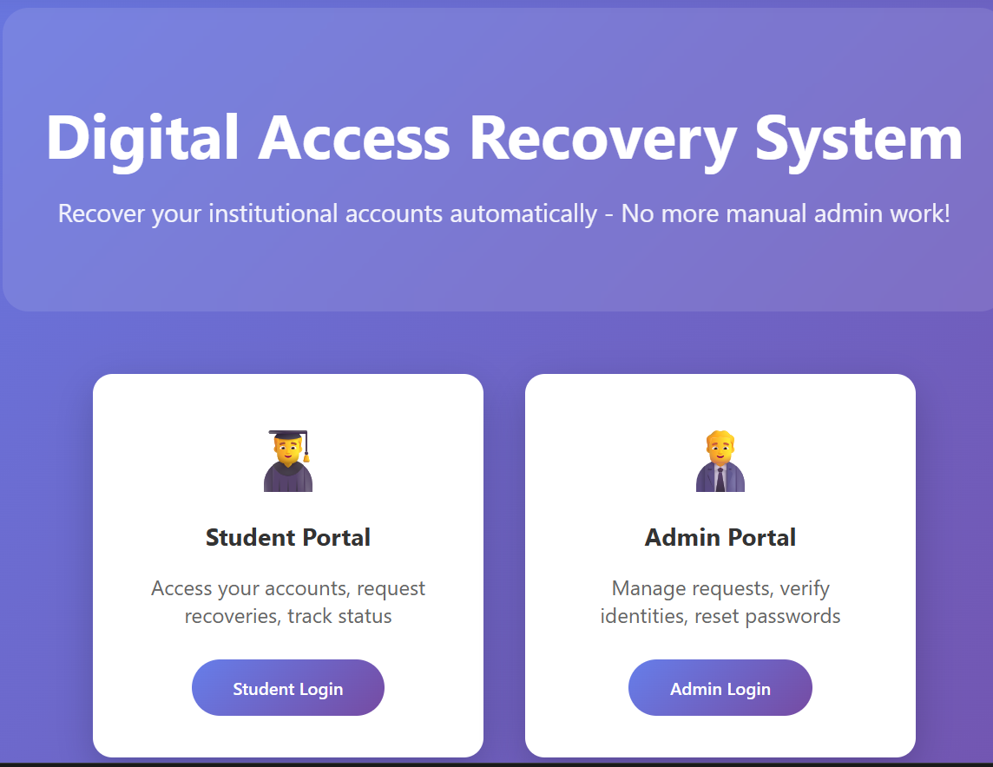
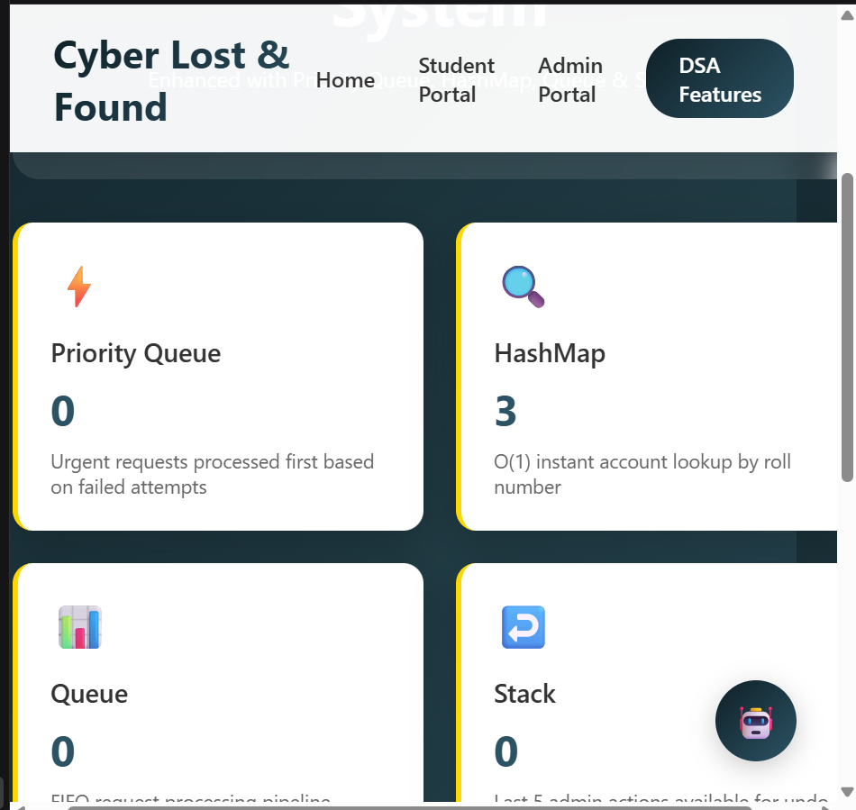
Screenshots for FWD & DSA

Slide 22
Conclusion
The system provides a secure and efficient platform to recover lost digital accounts and credentials.
It reduces manual effort for administrators by organizing recovery requests digitally.
The platform ensures faster communication between users and admins during the recovery process.
It improves data safety and accountability by maintaining proper records of requests and actions.
The system offers a user-friendly interface for students and administrators to manage recovery tasks easily.
Overall, the project helps create a reliable and organized solution for managing lost digital access in institutions

Slide 23
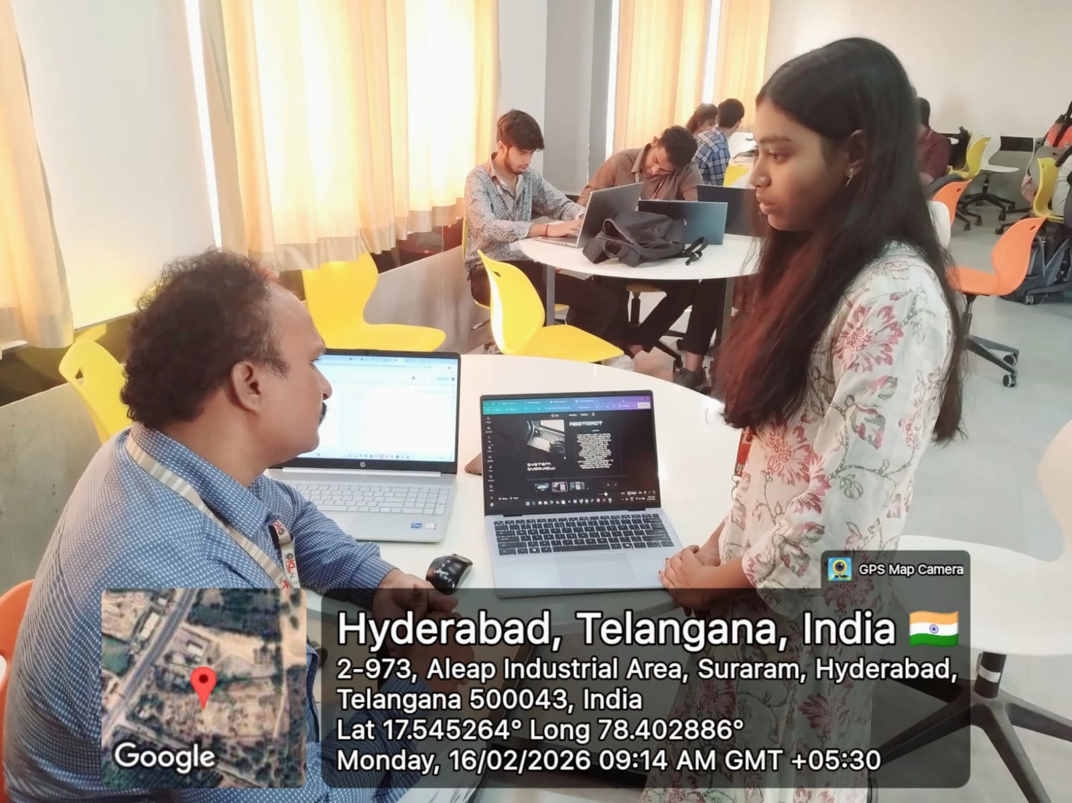
Geo- Tag Photos

Slide 24
Thank You

